Slide 1
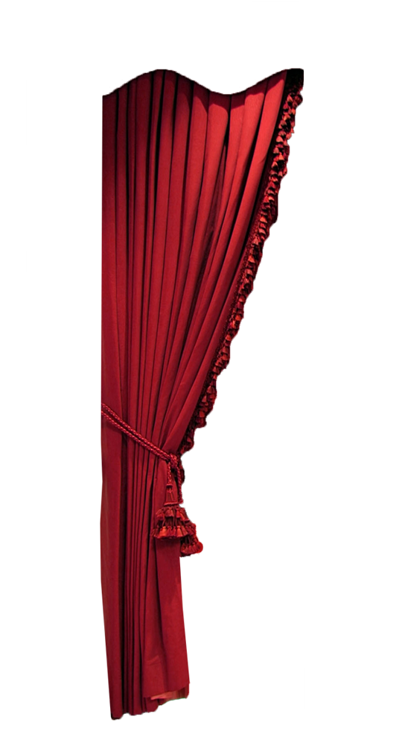
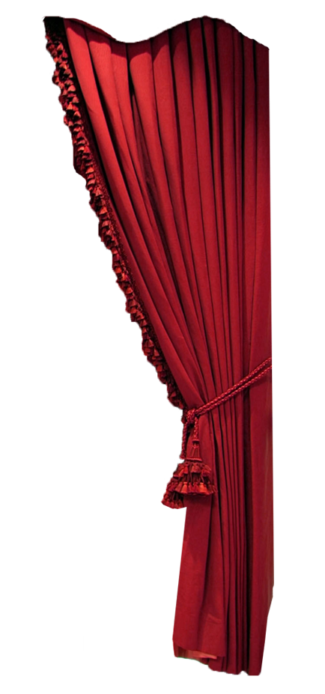
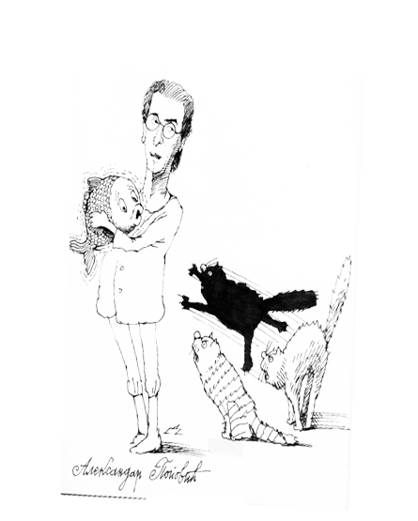
Multimedia project Aleksandar Aca Popovic
Ana Vukadinović
Bojana Mitrović
Igor Valjević
Miloš Vojinović
Miloš Đurić

Slide 2
Project motivation
Why Aca Popovic?
One of our most important playwright
He brought avant-garde in Serbian theaters
Material in digital form is scarce

Slide 3
Project involvement
Students from the Faculty of Mathematics, University of Belgrade – Department of Computer Science and Informatics
Students from the Faculty of Philology, University of Belgrade – Department of Library Science
Coordinated by prof. Gordana Pavlović-Lažetić and prof. Cvetana Krstev

Slide 4
Project supported by
Faculty of Mathematics, University of Belgrade
Faculty of Philology, University of Belgrade
Other institutions:
Serbian Museum of Theater Art, Belgrade
Radio Belgrade
“Jovan Tomić” Library, Nova Varoš
Cultural Center “Jovan Tomić“, Nova Varoš
Library of Yugoslavian Film Archive
Library of Serbian National Theater, Novi Sad

Slide 5
Project supported by
Other institutions:
Šabac Theater, Šabac
Zvezdara Theatar, Belgrade
Steria’s pozorje, Novi Sad
Yugoslavian Drama Theater, Belgrade
Bitef Theater, Belgrade
Radio Television of Serbia, Belgrade
National Theater, Belgrade

Slide 6
Project facts I
15 Institutions involved in the project
293 Pictures of:
Portraits
Theatre performances
Theatre bills
Other
91 Articles from about 10 different newspapers:
Politika, Nin, Borba, Svet, etc.

Slide 7
Project facts II
130 minutes of audio recordings
Radio drama
Biography
Other
8 hours of video recording
Excerpt from different plays
Interview
Other
5Gb gigabytes of data in Multimedia database

Slide 8
Technologies used - SMIL
SMIL - Synchronized Multimedia Integration Language
W3C recommendation for making Multimedia Presentations
Markup language
Support for different media players (Adobe Media Player, Windows Media Player, etc.)
Support for combining with XML and XML based standards (SVG animation, RSS, other…)

Slide 9
Technologies used - SMIL
Content parallelization
Absolute automatic control of the time manipulation over content representation
SMIL file contains the following:
* The layout of the presentation * The timeline of the presentation * The source of the multimedia elements

Slide 10
Technologies used - XML
XML - Extensible Markup Language
Picture description in the gallery

Slide 11
Multimedia project “Aleksandar Aca Popović”
DEMO

Slide 12
Challenges and difficulties
Scarce material
“Jovan Tomić” Library, Nova Varoš
Cultural Center “Jovan Tomić“, Nova Varoš
Library of Serbian National Theater, Novi Sad
Šabac Theater, Šabac
Steria’s pozorje, Novi Sad
State of materials
Extracting data from collected material

Slide 13
Future development
Multimedia database
Storage – done
Access – done
Retrieval – in process
Data mining?
Collecting and procesing new material for this project, to get more detailed view of his work.
Continuation of cooperation with the Faculty of Philology on digitalization of other playwrights– supported by Serbian Museum of Theater Art

Slide 14
Thank you!
Q&A

