Slide 1
Digitalization and Audio Mastering (restoration) in Institute of Artstudies - Sofia
www.artstudies.bg
www.aleksnushev.com

Slide 2
I part
Introduction
Presentation of existing vinyl’s in our archive
A few words about BAARTI project which is the main financial “backbone”.
Our hardware (laser turntable, hardware ELP declicker with 88 khz high-grade AD converter, vacuum cleaner for lp’s, TC electronics professional ASIO compatible audio interface etc.)

Slide 3
II part
The main part is dedicated to the concrete processing applications like crackle, hiss and pops removal, multiband compression, RMS level optimization, pitch correction and similar. The workflow is samplitude master edition supported by waves restoration - mastering plug ins and UAD card with master bundle.
The conclusion polemize about the question “do we need to do all this processing?” Or better leave it untouched. Also a few words about audio digital database, data storage, back up and perspective’s.

Slide 4
Introduction
The Institute of Art Studies at the Bulgarian Academy of Sciences, exist for over 60 years.
The Background of digitalization of music in Art of Studies is The project WebFolk.BG, which is a result of over 5 year work, realized by a research team under the conduction of Dr. Lubomir Kavaldjiev.

Slide 5
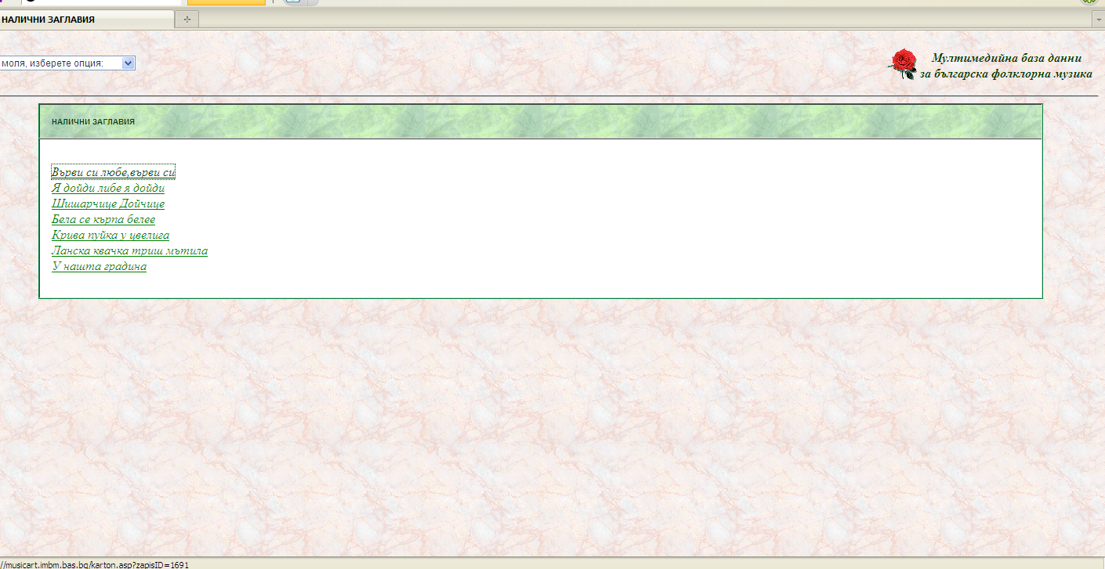

Slide 6
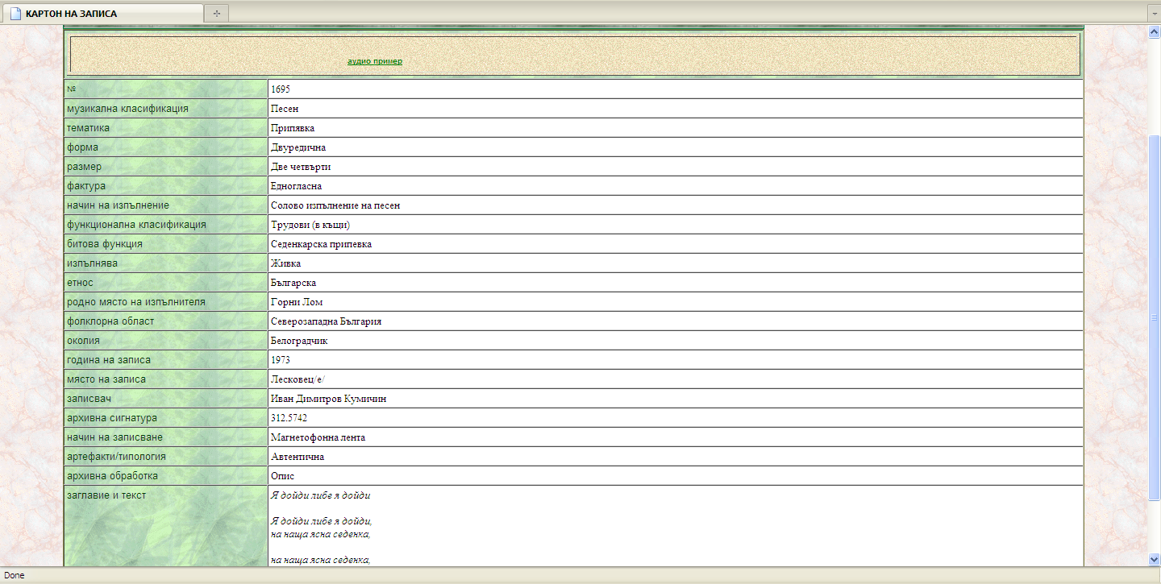

Slide 7
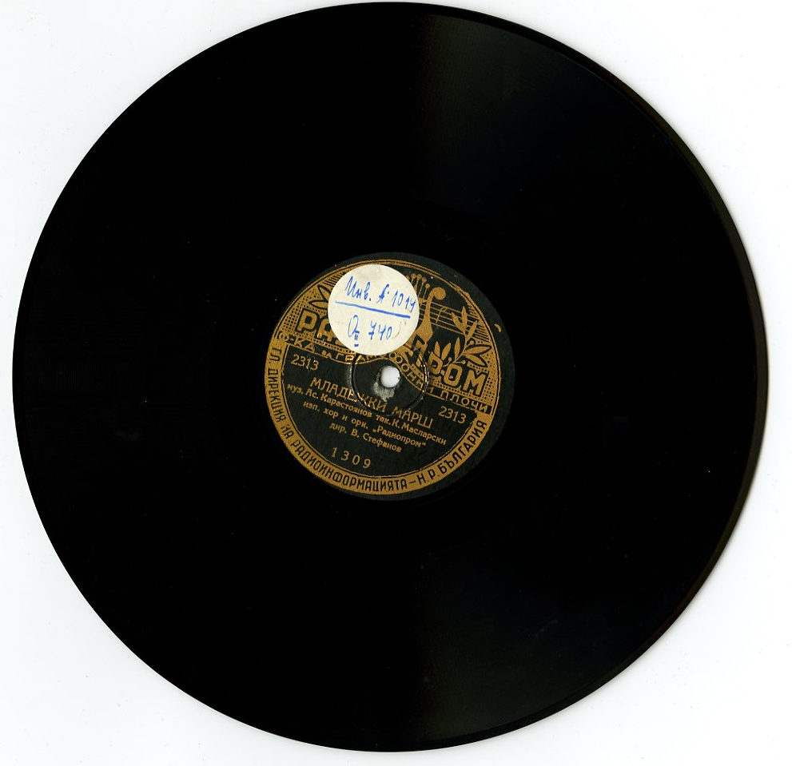
Institute of Art possesses a rich collection of old records (records for scientific purposes and commercial boards) - a unique and quantity and content. It's a collection of about 1500 plates on which the recordings were made during the first half of XX century.

Slide 8
Bulgarian Art Archives and Advanced
Research Technologies
(BAAART)
Project director : Assoc. Prof. Alexander Yanakiev, DS:
The main aims of this project are to digitalize the following materials in a short period of time:
• currently existing archives
· to initiate creation of archives of important contemporary art events Realization of these difficult tasks is facilitated by the fact that an enormous amount of data collected by the research fellows of the Institute of Art Studies already exists in four fields:
- fine arts (ancient, medieval, and modern art}
- music (folklore, liturgical songs, contemporary music)
- theatre (20th century, contemporary theatre,· cinema (fiction movies, documentary films,
animation)
These archives are divided into:
· photo-archives,
• bibliographical catalogues,
· textual archives,
• audio·visual archives,
• micro-film archive

Slide 9
Participants – 32 persons. Including 16 scholars and 5 PhD students.
Project Leader – Prof. D.Sc. Alexander Yanakiev
Strategic objective(s) addressed
The outcomes of the proposed project will be:
contribution to research technological development (RTD) capacity building as an initiative of the European Union by creation of digitalised archives of Bulgarian art, music, theatre, film heritage,
bridging the past, present and future of Bulgarian art, music, theatre, film studies in the frame of the initiated by the Institute of Art Studies strategy for popularization of the Bulgarian cultural heritage as a part of the European one,
creating opportunity for coordination and relevancy of Bulgarian art studies projects with the European programmes and initiatives,
increased networking between the scholars, specialist, post-graduates, students and all interested in art studies, disseminating scientific information as well as the results of research by providing seminars, conference, publications, facilitating communication between centres having similar scientific interests by helping the easier access to the Bulgarian art heritage,
increased job opportunities for young scholars in the field of art studies such as research fellows, post-graduates, students as a measure to avoid “brain drain” phenomena by creating better carrier opportunities, better work conditions, access to hi-tech infrastructures,

Slide 10
Acquired equipment and performed activities
Laser Turntable ELP Laser Turntаble LT-2XRC and accessories
Large format scanner - Kodak Filemaster+ A 2 book scanner
Work stations Hobit – the working and visitors places are equipped with these tools
VPN network created
Special software was made for the creation of the integrated data base
1500 records from the archive of the Institute of Art Studies were digitalized,
55 000 pages of old, valuable and endangered publications were scanned
Digitalized with the help of a photo-camera were 10 000 materials concerning different arts from newspapers and magazines
BAAART 1
Planned budget subsidy at time of application – 357 500 BGN, out of the total budget the Ministry of Education and Science is to provide 337 675 BGN
Granted subsidy by the Ministry of Education and Science – 145 000 BGN
Final budget – 155 000 BGN
Project Duration – December 2006 – November 2008

Slide 11
Bulgarian Art Archives and Advanced
Research Technologies
Part 2
(Modernization and Expansion)
(BAAART-2)
Planned budget subsidy at time of application – 60 000 BGN, out of the total budget the National Science Fund of the Ministry of Education and Science is to provide 48 800 BGN
Granted subsidy by the National Science Fund 48 000 BGN
Final Budget – 59 000 BGN
Project Duration– November 2007 – April 2009
Participants – 16 people. Including 8 scholars
Project Leader – Prof. D.Sc. Clair Levy
BAAART-2 – new and expanded possibilities
Creation of a virtual private network (VPN);
Increase in the number of user stations with access to digital resources via Hobit modules;
Subscriptions to international databases;
Creation of new databases;
Expansion of possibilities for digitalization of archive materials and library collections;
Expansion of the server capacity for data;
Improvement of services for users of the archives;
Possibilities for the presentation of academic accomplishments and archives.

Slide 12
Our audio hardware
The performance of the Laser Turntable means "No Needle, No Wear ™." The LT features an absolutely contact-free optical pickup system. Play a record thousands of times with no damage to the record. Get the same sparkling sound on the thousandth play as on the first play.
The Laser Turntable allows you to...
· Play your Vinyl Records without damaging them.
· Discover great new analog sound in your Vinyl Records.
· Play damaged Records with better results than a needle.
· Have the convenience, control, and safety of playing Vinyl Records just like a modern CD player (the record is contained inside the machine, and with a remote control you can click to play any track while the LT tells you the elapsed & remaining times).

Slide 13
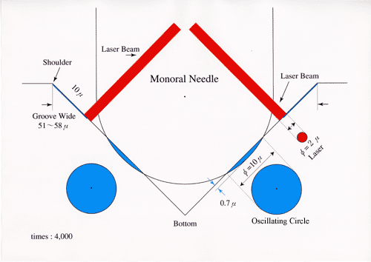
The Laser Turntable System
Laser Reads New Audio Information
The same audio information is engraved from the shoulder to the bottom of a record groove. Audio information read by the laser is 10 microns below the shoulder (see below). Therefore, the laser is picking up audio information which never been touched/damaged by a needle. It plays the virgin audio information on the groove without an digitization.
Laser Turntable has Five Laser Beams
• The first two beams aim at the left and right shoulders of the groove for tracking.
• The next two read the stereo sound at 10 microns below the shoulder (the standard position).
• The final beam maintains the height between the laser head and the surface of record, to manage thicker or warped records.

Slide 14
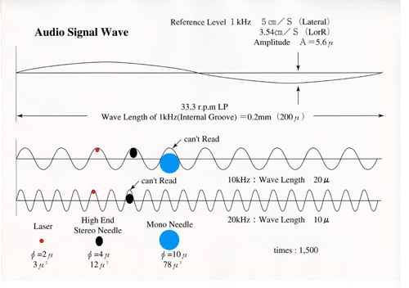

Slide 15
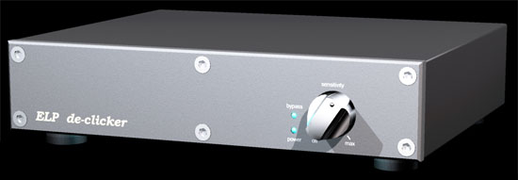
The ELP declicker is compatible with both the ELP Laser Turntable and conventional turntables. We've listed some of the other great features of this new product below.
· Real-time noise reduction of clicks and crackle (impulse noise), but not hiss (broadband noise).
· No other hardware is required. Not even a computer.
· Click/crackle sensitivity is continuously variable using a single rotary control. When the sensitivity is set to "minimum" there will be minimum noise reduction and negligible effect on the signal.
· Bypass allows the user to leave the ELP declicker in the signal path with no noise reduction.
Bypass is easily switched on and off with a front-panel control.
Bypass operates in two modes:

Slide 16
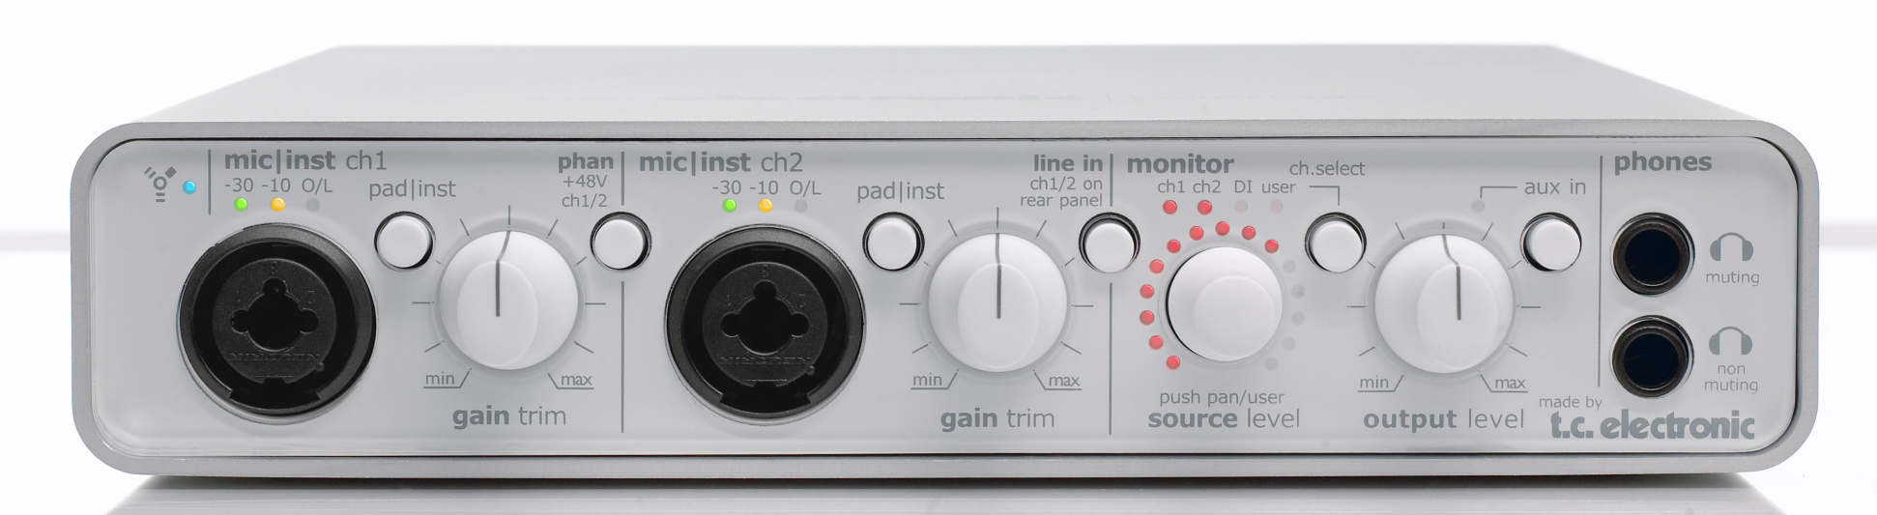
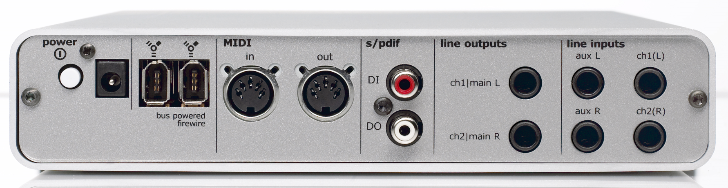

Slide 17
Sound optimization process
The priority of all Audio processes in institute of Art study is to transfer the data in best possible quality and to optimize it for using it in our databases. That’s why, we choose Samplutude as main audio workstation:
Works undestructive with audio material – that’s mean that all transferred data are saved without any processing in separate folder.
Real time - Object editing mode – give us possibility to edit little part of audio material without destruct or process the selected audio in the back up folder
Possibility for real time variable pitch shifting which is so, so usefull with old reel to reel tapes and old gramophone plates, where the speed is not constant. Actually I use this function only in case of request.
Make ID3 tags and CD audio text + full professional red book CD audio mastering.

Slide 18
Here are some steps of audio “mastering” process after transfer (for example 78 speed vinyl record):
Usually they are mono, but there is some differences in Left and Right Chanel which I want to preserve. But If the difference is in level and it’s more than 2 decibels – I correct it. I never do mono export, the result file is stereo 320 kbps mp3 file.
Get a noise print to make a quality 24 bit noise reduction
Un Crackle and declicker process. Don’t forget that the transfer is made trough hardware declicker – it means that it is second declick procces.
Filter with High pass at 40, 60, 80 or 100 Hz – depends on program material.
Pitch, time correction – if necessary. Sometimes the laser beam jumps in next groove – I have to correct it.
Slightly compression with light parameters for little peak reduction and level optimization – if necessary.
Final Limiter – for achieving RMS loudness level of – 12 db
Manual level adjustment of different songs.
Timing corrections – fade ins, and fade outs. Track indicators for beginning and endings. Put ID3 tags (usually the tags are job of database operators)
Export to mp3

Slide 19
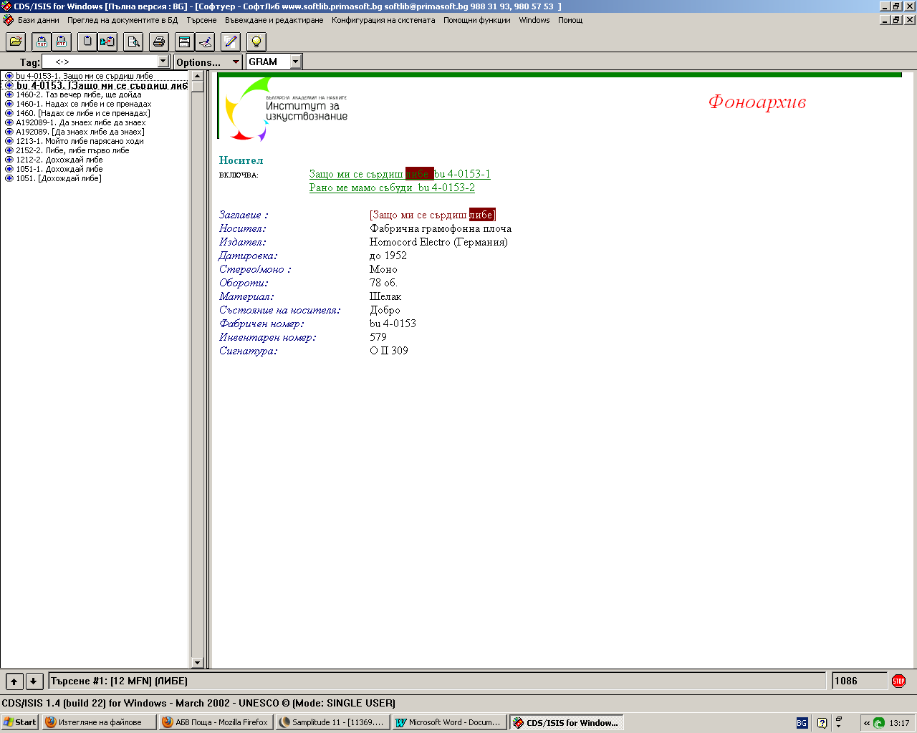
Our Database – screenshots from Soft Lib software:

Slide 20
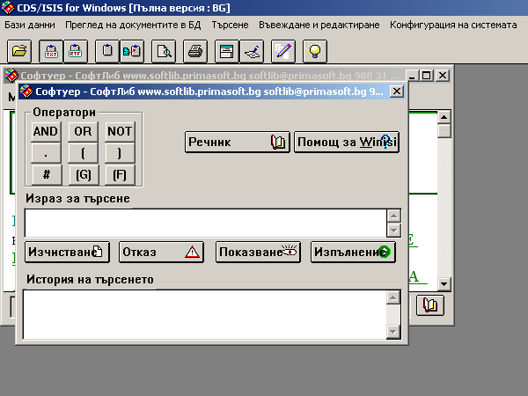

Slide 21
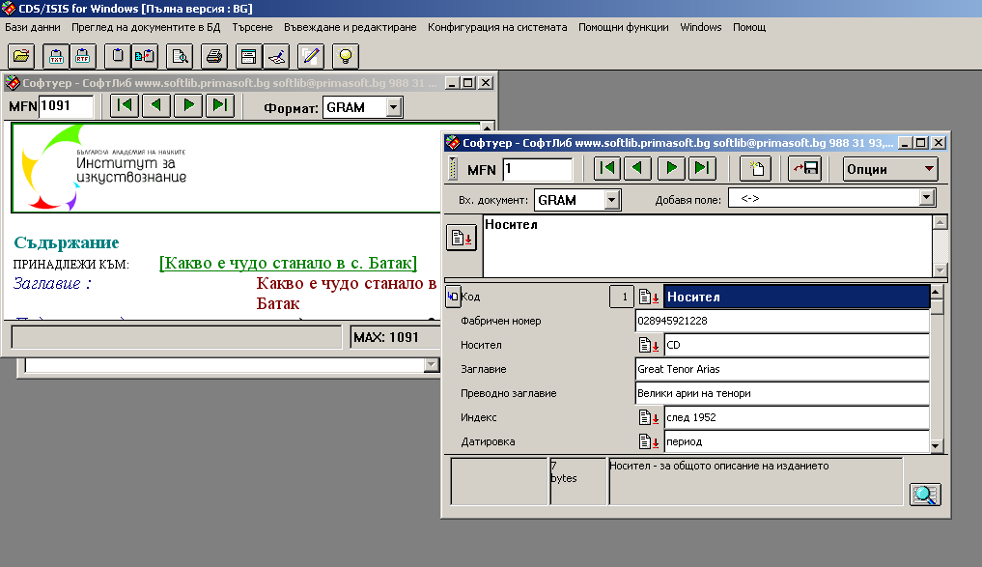

Slide 22
Aleks Nushev
computermusic@abv.bg
www.artstudies.bg
www.aleksnushev.com

