Slide 1


Milena Dobreva & Pierluigi Feliciati
User-centric evaluation of Digital Libraries:
Two Case Studies
Notes:
1
1

Slide 2
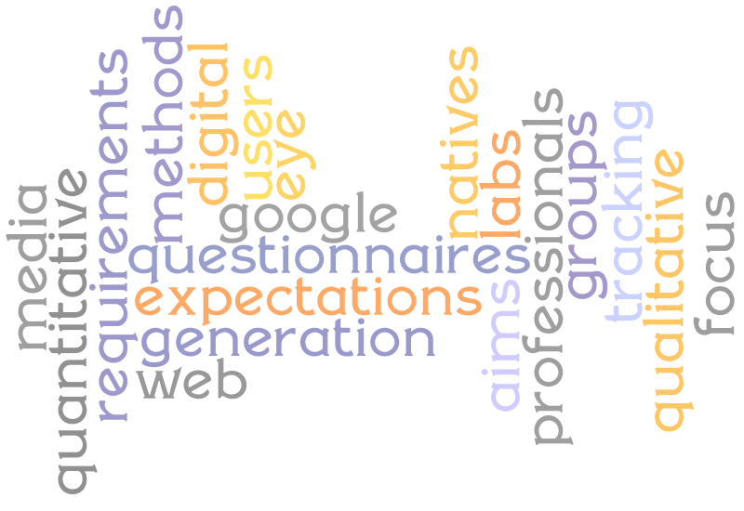
USER-CENTRIC STUDIES OF DL
Notes:
2

Slide 3

Context
Anneli Sundqvist “the general knowledge of user behaviour is a mixture of common sense, presumptions and prejudices” in a study of digitised archives. (2007):
The Institute of Museum and Library Services: “The most frequently-used needs assessment methods do not directly involve the users” (2003).
Michael Khoo et al.: “In the case of digital library researchers, the focus of research is often on technical issues (e.g., information retrieval methods, software architecture, etc.) rather than on user-centered issues. When these researchers turn to user based evaluations, they therefore often lack the necessary expertise to develop robust Human Computer Interaction (HCI) experiments, and their goals are typically limited to "proof of concept" tests, rather than prescribing user motivations or cognitive impacts.” (2009).
Notes:
3
3

Slide 4
User-study methods
Methods based on direct user involvement
  Quantitative
    Questionnaires
    Experiments (media labs, user
behaviour)‏
  Qualitative
    Focus groups
    Semi-structured interviews
    User panels
  Mixed
    Diary studies
Methods based on indirect observation
  Deep log analysis
Personae
Notes:
4
4

Slide 5
The last MINERVA step:
Handbook on Cultural Web User Interaction
Goals and target
To answer to some questions still unsolved in previous MINERVA quality tools:
  What do users want?
  How do users behave?
  How can we understand the use they make of our web applications?
  Do effective methods to ask users about their expectations (before) and their degree of satisfaction (after) exist?
The handbook target readers are all the cultural subjects and projects concerned with tangible and intangible cultural heritage, planning to develop new web applications or to update and improve their existing applications, taking into serious account the users point of view.
Notes:
5
5

Slide 6
Handbook on Cultural
Web User Interaction
Freely readble and downloadable
(under a Creative Commons Attribution Non-Commercial
Share Alike 2.5 (by-nc-sa) License)‏
Printed, XHTML and PDF versions
Engish (2008) and Italian (2009) versions
Ready to be translated/adapted (same license)‏
Applied on Culturaitalia (online questionnaire)
and AIB-WEB (see further)‏
See: http://www.minervaeurope.org/publications/handbookwebusers.htm
Notes:
6
6

Slide 7
What are our challenges?
Human behaviour is difficult to study: under observation it changes.
Multiple methodologies – difficult to choose.
Time consuming and expensive.
Requires experienced facilitators/analysts.
Lack of coordination means multiple smaller studies are done but there is no benchmarking in this area (yet).
Connected to evaluation of QUALITY of websites – which is far from consensus.
Notes:
7
7

Slide 8
This presentation:
2 case studies
What were the aims?
What methods were selected?
How they were applied?
What were the difficulties/lessons learnt?
What were the outcomes?
Notes:
8
8

Slide 9

1. AIB-WEB
Do professional users need
to go over traditions?
http://www.aib.it
The user study was conducted by Pierluigi Feliciati (University of Macerata) and Maria Teresa Natale (OTEBAC- Italy), both AIB associated, in accordance with AIB-WEB coordination board.
Notes:
9

Slide 10
Research context
The Associazione Italiana Biblioteche is the professional association of Italian librarians. Founded in 1930, AIB is the only general library association in Italy, the only National Association Member of IFLA, and by far the oldest and largest association from this field in Italy.
The members, some 4,500+, are mostly librarians, but membership is open to libraries and other persons or bodies interested in the field (e.g. LIS students, international libraries and other organizations, private companies, etc.). Corporate bodies account for some 15% of total membership.
AIB-WEB, born on 1995 (on 1997 under this domain) has actually 15.000+ pages, created and maintained by a distributed editorial staff (120+ people). It promotes the principles for the accessibility to web contents in general and to libraries' contents in particular.
Notes:
10
10

Slide 11
What were the aims?
AIB-WEB, over the years, has always been focused on the content, in the name of accessibility and simplicity, sacrificing some elements such as graphics, presentation, inclusion of multimedia content.
An admirable severity in the definition and management of a universal access policy was not accompanied by a gradual adjustment of the rich and complex web site to the obvious web environment changes (both technical and in users interaction).
After the decision of AIB to proceed with the redesign and restructuring of AIB-WEB, from a static model of implementation of the pages using a CMS, the editorial board has decided to conduct a users satisfaction survey, to base on the remodelling of the site and its future enrichment.
Notes:
11
11

Slide 12
Method: web questionnaire
The standardized interview is a reporting system with the direct involvement of subjects to be analyzed, proposing - to all users via Web - a series of structured questions.
For AIB-WEB we choosed the method of unrestricted self-selected survey: the sample is open and the survey is publicized through calls via Web portals, popular websites, discussion lists, etc. The questionnaire was administered via the Web platform SurveyMonkey, an on line service for creating instant polls.
The questionnaire was composed by 37 questions, organized in 6 sections: open/closed questions, with predefined answers, free text, multiple choice answers and/or votes. A lot of users (645) answered, and 74,7% filled the entire questionnaire.
Notes:
12
12

Slide 13
Lessons learnt
Pro's:
  Excellent response, both in terms of quality and quantity.
  The target community (and some more) showed to feel involved.
Con's
  Too much extra time needed for analysis of free text answers.
  Some contradictions between closed-choice questions and free-text.
  Not easy to extract clear recommendations.
Notes:
13
13

Slide 14
Outcomes
Method
  Low cost of the survey, limited to the use of SurveyMonkey pro platform.
  Possibility to reach people distributed throughout the area (and more: 4 users were based outside of Italy)‏.
Application to the real case
  Most of users need an update and are aware of what does it mean “content quality”.
  Many users expressed a need of interaction and some precise proposals for web site updating.
  The research was followed by AIB-WEB board since its beginning and the results will be published on AIB Bullettin Journal.
Notes:
14
14

Slide 15

2. EUROPEANA USER AND FUNCTIONALITY TESTING
October 2009 – January 2010
CDLR, Università degli studi di Macerata, Glasgow Caledonian University
Team: Milena Dobreva, Emma McCulloch, Duncan Birrell,
Pierluigi Feliciati, Ian Ruthven, Jonathan Sykes, Yurdagül Ünal
Notes:
15

Slide 16
What were the aims/
target users?
  A principal objective of Europeana.eu is to engage young people
    learning experience / personal enrichment
  Their needs and expectations change most rapidly
    Google generation / digital natives
  Quantitative study – the web survey, April 2009
    Detailed qualitative analyses of user behaviour, paying particular attention to students
Notes:
16
16

Slide 17
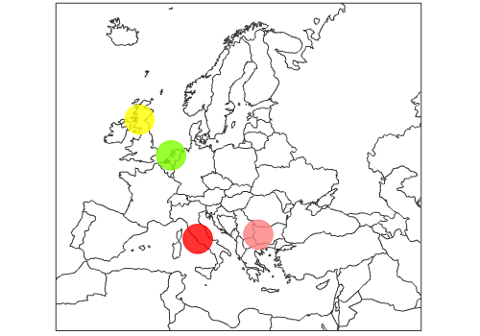
Target users and methods
24 participants
1 focus group - general public,
media labs
2 groups,
secondary schools
23 participants
2 groups,
secondary school
1 group, uni students
20 participants
Notes:
17
17

Slide 18
Methodology
Introduction
Questionnaire 1 – demographic data
Brief introduction (Еuropeana)
Questionnaire 2 - first impressions
Discussion (first impressions)‏
Task: virtual portrait of the city
Second discussion (lasting impressions)‏
Conclusion + questionnaire 3 - lasting impressions
Notes:
18
18

Slide 19
Outcomes vs aims
  Quantitative data
    Demographic data
    Self-evaluation of web search skills
    Attitudes towards culture
    Dichotomic pairs
    Eye tracking
    Queries analysis
    Populated presentation slides
  Qualitative data
    Several hundreds of statements from the discussions
    Bubbles – Europeana is about…
Notes:
19
19

Slide 20
Initial vs lasting
impressions
Notes:
20
20

Slide 21
Initial positive impressions
Notes:
21
21

Slide 22
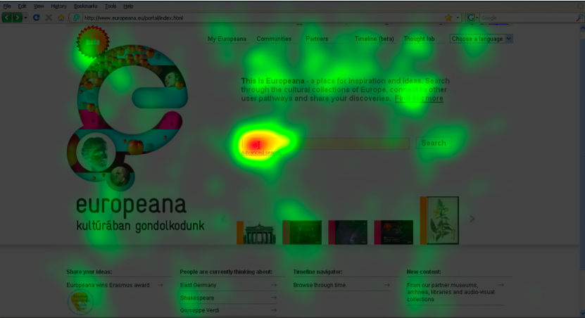
Heat maps
Notes:
22
22

Slide 23
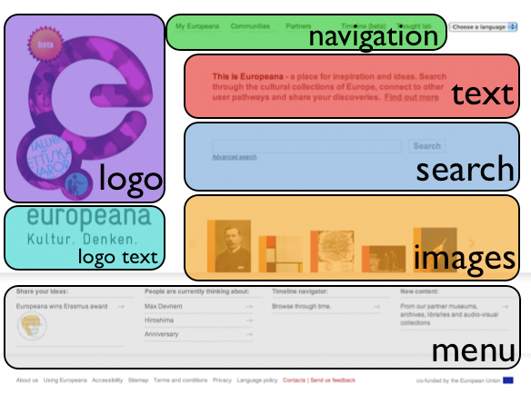
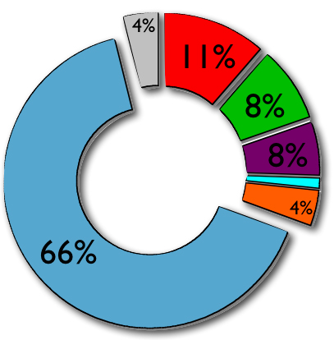
Home page
Areas of interest
Fixation (%)‏
Notes:
23
23

Slide 24
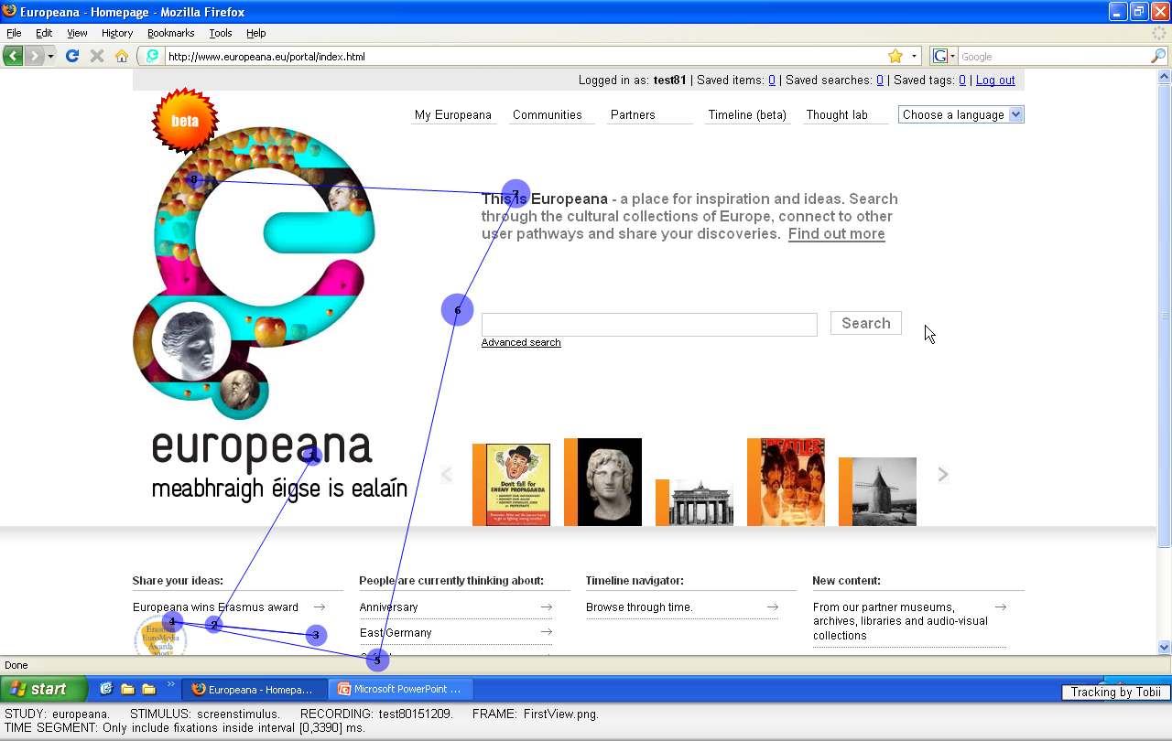
Gaze plots
Notes:
24
24

Slide 25
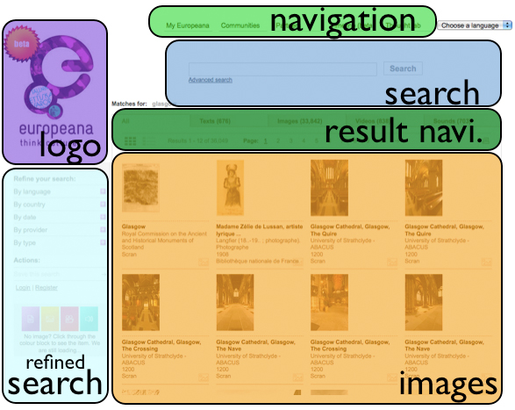
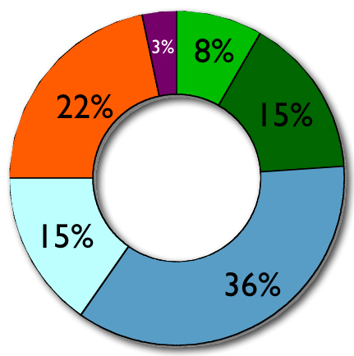
Search screen
Areas of interest
Fixation (%)‏
Notes:
25
25

Slide 26
Challenges
2 types of users
4 countries
Combination of focus groups and media labs
How to gather a rich feedback?
Qualitative study + evidence-based approach.
Notes:
26
26

Slide 27
Outcomes
Synthesis of suggestions for change (24)
  Content
  Functionality/usability
  Navigation
Some are issues on which Europeana already works – reassurance of direction
  E.g. include more contemporary material.
Some seem too complicated to reach but is useful to know about
  E.g. translate all the metadata and objects into different languages
Notes:
27
27

Slide 28
CONCLUSIONS
Notes:
28

Slide 29
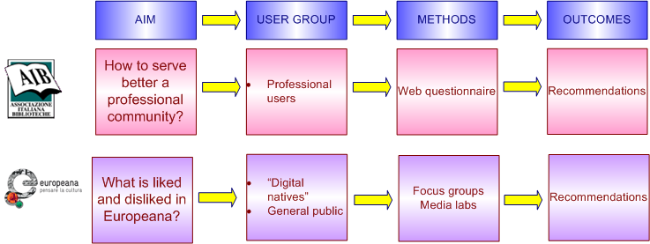
The case studies
at a glance
Notes:
29
29

Slide 30
So, what?
It is still common not to consult the
users in the digital domain addressing some specific content gap or looking for technological innovation.
We have a range of methods which can be used but not a common research framework.
We need to look more into areas such as personalisation and recommender systems.
We also need to establish some benchmarks.
Notes:
30
30

Slide 31
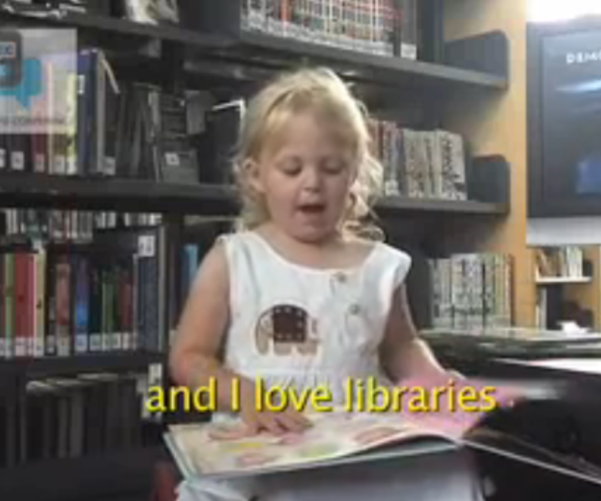
And we should not
forget who comes next!
Notes:
31
31

Slide 32

SOURCES
Quality Principles for Cultural Websites: a Handbook, MINERVA project, 2005 http://www.minervaeurope.org/publications/qualitycommentary/qualitycommentary050314final.pdf
Handbook on cultural web interaction, MINEVA project, 2008 http://www.minervaeurope.org/publications/handbookwebusers.htm
Google generation (2008)
http://www.jisc.ac.uk/whatwedo/programmes/resourcediscovery/googlegen.aspx
IMLS (2003). Assessment of End-User Needs in IMLS-Funded Digitization Projects, 41 pp. http://www.imls.gov/pdf/userneedsassessment.pdf
Khoo, M., G. Buchanan, S.J. Cunningham, Lightweight user-friendly evaluation knowledge for digital libraries, D-Lib Magazine, July/August 2009, http://www.dlib.org/dlib/july09/khoo/07khoo.html
Notes:
32

Slide 33
SOURCES
Sundqvist, A. (2007). The use of records – a literature review. Archives & Social Studies: A Journal of Interdisciplinary Research, 1(1), 623-653.
Dobreva M., McCulloch E., Birrell D., Feliciati P., Ruthven I., Sykes J., Unal Y. User and Functional Testing. Final report. Europeana v. 1.0. 180 pp. (2010). Available: http://version1.europeana.eu/web/europeana-project/documents
Abbey’s story: “Abbey is a 3 year old digital native. This is what she wants from her library.” Abbey's video launches the 15th Biennial VALA Conference and Exhibition in Melbourne Australia (2010). Source: http://www.youtube.com/watch?v=7_zzPBbXjWs
Notes:
33

