Slide 1
The Emperor's New Digital Suit
Žarko Mijajlović¹, Aleksandar Pejović², Vojin Jovanović³ i Dušan Vasiljević⁴

Slide 2
Introduction
Virtual Library of Mathematical Faculty of the Belgrade University (http://elibrary.matf.bg.ac.rs/)
  Original design (2004)
    Simple web application for administering and searching the database
  Today
    One of the biggest public digital libraries in Serbia
    800 books, 360 dissertations

Slide 3
New requirements
More flexible workflows
  Per collection
Better copyright support
Better interoperability
  Search engines
  Google Scholar

Slide 4
Open source solutions
Greenstone
  Not suited for making a digital repository
  C, Perl and Java based
Fez based on Fedora Core
  Java and PHP based
DSpace
  All Java solution

Slide 5
DSpace
Large community
  Over 800 organizations
  MIT, Harvard, Cambridge, NASA, etc.
Completely customizable
  User interface
  Metadata
  Workflows
OAI-PMH compatible
Configurable Browse and Search

Slide 6
New Virtual library
Custom metadata
  DC based
  Thesis specific
  More thoroughly described authors
Localized to Serbian
Custom user interface
  Look and feel are matching site of Mathematical Faculty of Belgrade University

Slide 7
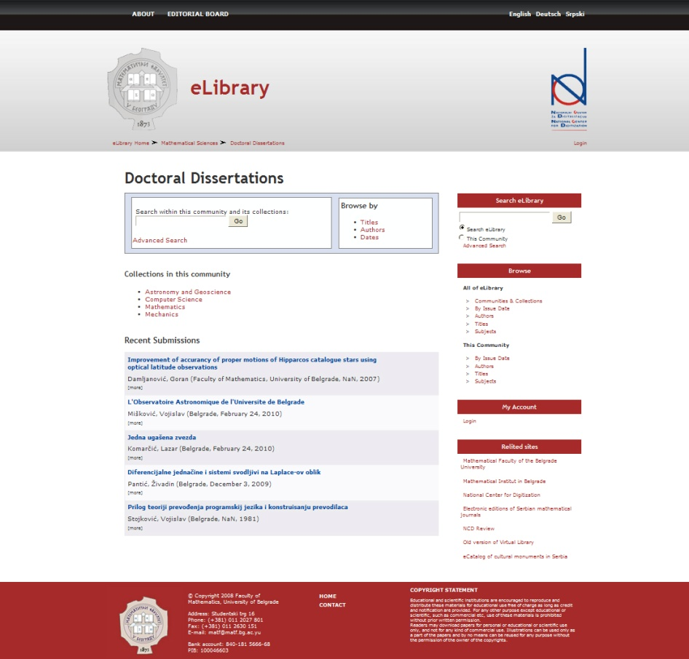
Conclusion
Transition is still in progress
Data transfer went without any serious problems
Real benefits in long run
  Large community
  Interoperability

Slide 8
Contact information
^{1, 4} Faculty of Mathematics,
Studentski Trg 16,
Belgrade, Serbia
¹ zarkom@matf.bg.ac.rs,
⁴ vdusan@matf.bg.ac.rs
^{2, 3} Mathematical Institute SASA,
Kneza Mihaila 36,
Belgrade, Serbia
³ pejovica@mi.sanu.ac.rs,
⁴ vjovanovic@mi.sanu.ac.rs

